Slide 1


AI ROBUSTNESS AGAINST ADVERSARIAL ATTACKS
Neural Network compression of ACAS-Xu
Pierre OLLIVIER
Tom LABIAUSSE
Thomas GHOBRIL
Shruthi SUNDARANAND
Vincent MICHELANGELI
June 3rd, 2022

Slide 2
01
Introduction
IRT SystemX, ACAS-Xu & adversarial AI
1/11

Slide 3
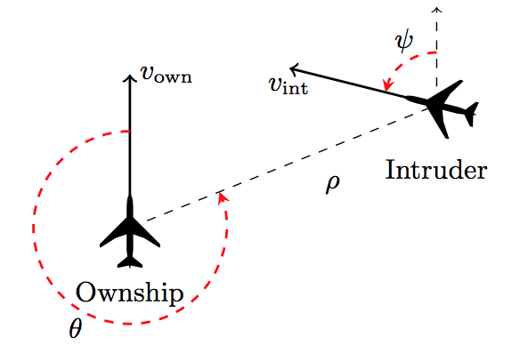
Introduction
AI project in partnership with IRT SystemX
Leader in research projects and digital engineering for the future mixing industrial and academic partners
Aim of the project : characterize an AI model by its robustness and evaluate it against various adversarial attacks
Compare the performance of different attacks
Quantify the validity of safety properties on an AI system
A study of the ACAS-Xu system, which is an airborne collision avoidance system designed for unmanned aircrafts.
Aircraft encounter
(adapted from [Katz and al 2017])

Slide 4
02
ACAS-Xu
Airborne Collision Avoidance System
2/11

Slide 5
ACAS & ACAS-Xu
ACAS (Airborne Collision Avoidance System) is a system that aims to prevent aircraft collisions
ACAS-Xu focuses on unmanned aircrafts (since 2010s)
There are two subproblems that ACAS-Xu hopes to solve:
Threat detection : is this aircraft in the collision threshold?
Threat resolution : how to avoid it?
ACAS-Xu is based on look-up tables and uses dynamic programming to determine horizontal or vertical resolution advisories to avoid collisions with minimal disruptive alerts.

Slide 6
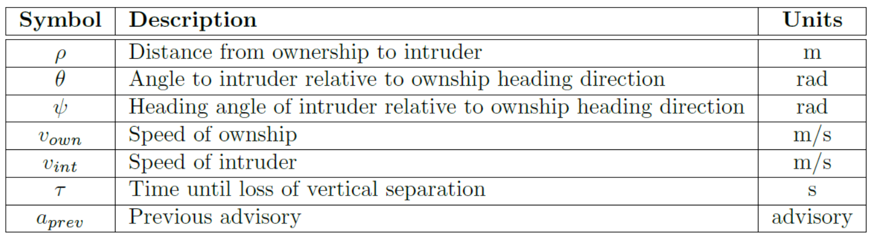
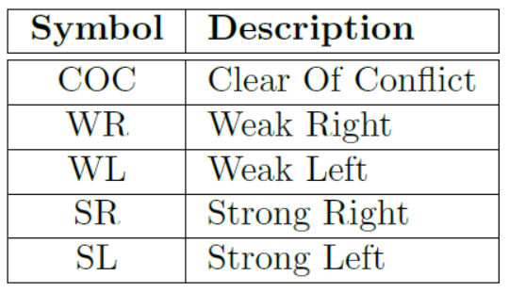
Neural Network compression of ACAS-Xu
Use a neural network to approximate the look-up table
Only need to store the parameters of the neural network
Easy and quick advice
Aircraft encounter
(adapted from [Katz and al 2017])
7 inputs of the system
5 outputs to evaluate

Slide 7

Neural Network compression of ACAS-Xu
Discretize $τ$into a set of 9 possible values
Discretize a_{prev} into a set of 5 possible values (5 possible advisories)
Create a neural network for each couple ($τ$, a_{prev})
Design 45 smaller neural networks with better performances

Slide 8
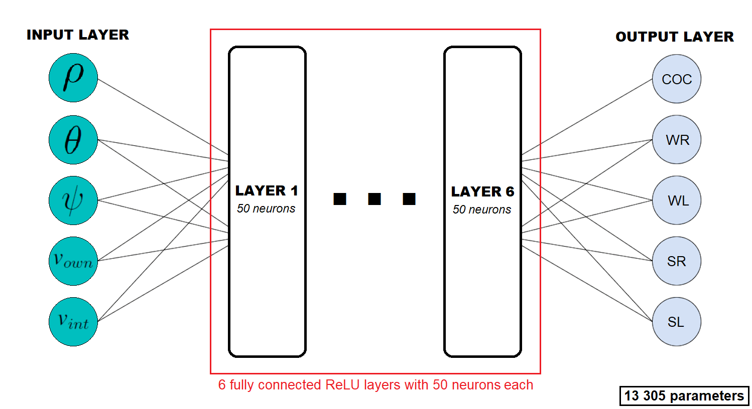
Neural Network compression of ACAS-Xu
Design 45 smaller neural networks (one for each possible couple ($τ$, a_{prev}))

Slide 9
03
Safety properties
Properties of the look-up table
3/11

Slide 10
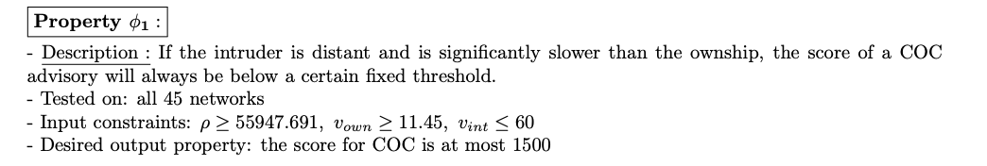
Properties
The neural network gives a table with sets of pairs – an input and output
To make system more trustworthy and scalable, we apply safety properties that need to be satisfied
SystemX provided us with a list of 10 properties that we should refer to
Example of a safety property

Slide 11
04
Adversarial attacks
A threat to the safety of ACAS-Xu
4/11

Slide 12
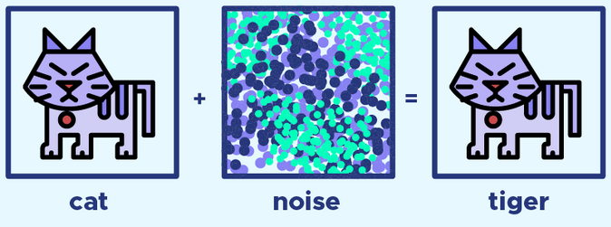
Feed models with deceptive data
Very bad consequences when it comes to aircraft!
Goal: observe the reaction of the neural networks to adversarial attacks
Understand the weaknesses
Improve the safety

Slide 13
05
Existing methods
A state of the art
5/11

Slide 14
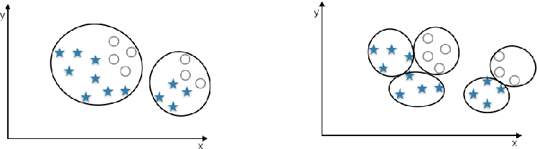
DEEPSAFE
Safe regions
Type of robustness
Regions where the network is robust
Label-guided clustering (kMeans + same labels)
Not attack based

Slide 15
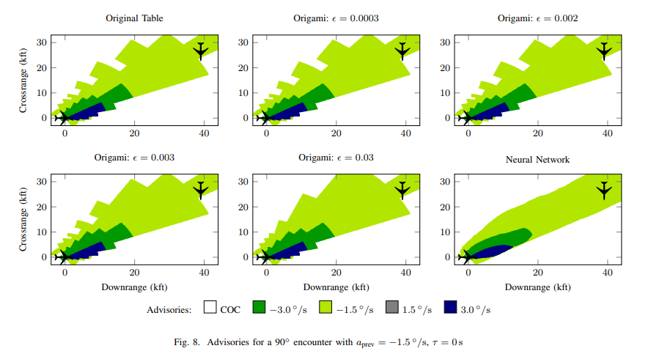
Importance of targeted robustness

Slide 16
RELUPLEX
Find adversarial examples using optimization
Inputs which predictions contradict the properties
Optimisation on linear and ReLU constraints
Not the same definition of robustness as before
Not attack based

Slide 17
Previous work
Attacks studied by the other team during semester 7 :
Wasserstein attack
Virtual Adversarial Method
Shadow attack
NewtonFool attack
Fast Gradient Sign Method (FGSM)
Carlini & Wagner attack
DeepFool attack
Iterative Frame Saliency attack
Auto-Projected Gradient Descent attack

Slide 18
Goals and strategy
06
What are the adversarial points? How to find them ?
6/11

Slide 19
DEFINING ADVERSARIAL ATTACKS
Changing the decision
Violating the properties
No access to the real labels : neural network 100% accurate
Small perturbation to change the decision
Respect input properties
Violating the output ones
Could do a combination of the two definitions

Slide 20
0
1
Select relevant networks
Apply existing attacks
STRATEGY
How to find adversarial points ?
2
Evaluate the robustness using metrics

Slide 21
07
Reducing the scope
Neural networks clustering
Attached deliverable : networks_analysis.ipynb
7/11

Slide 22
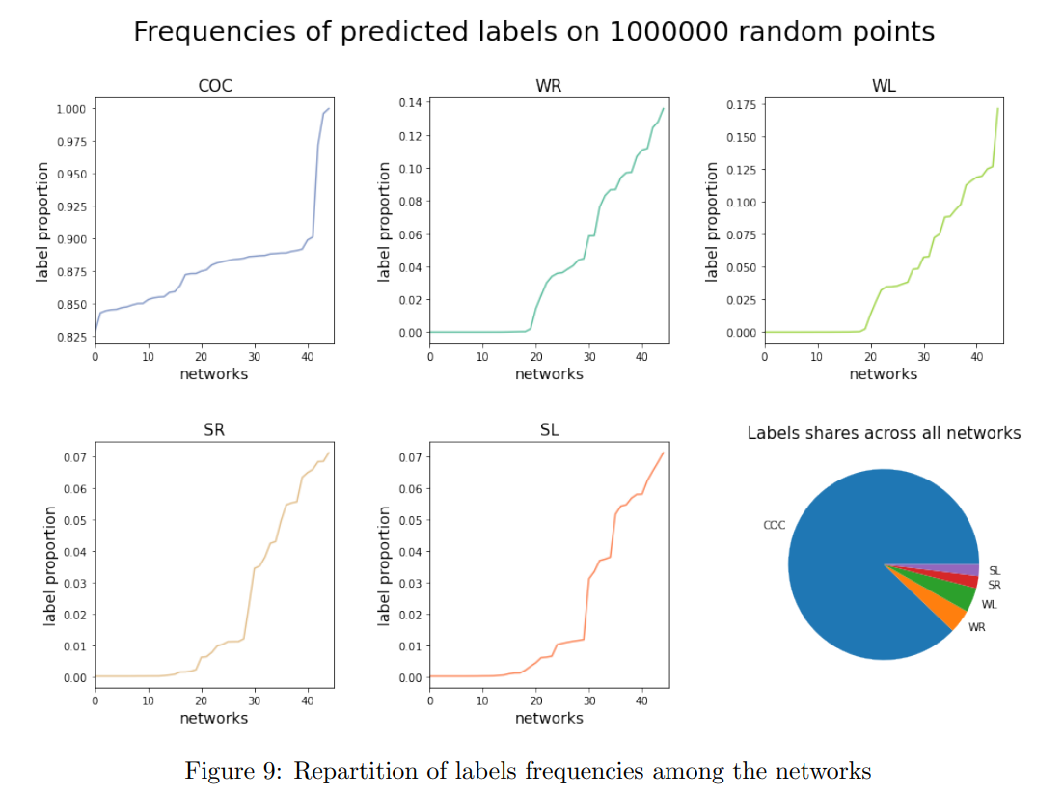
Clustering based on the network’s outputs

Slide 23
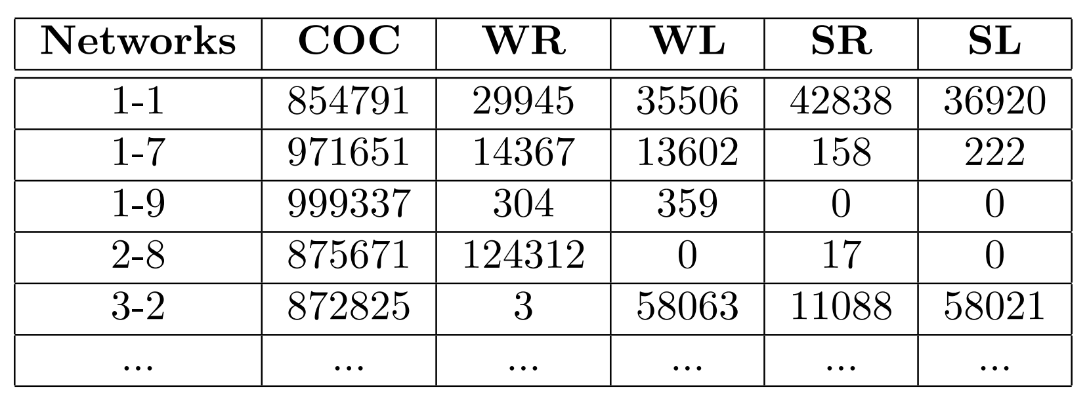
Clustering based on the network’s outputs
Predictions on a dataset
Output = 5 dimensions vector
Clustering of the networks on the distribution of the outputs

Slide 24
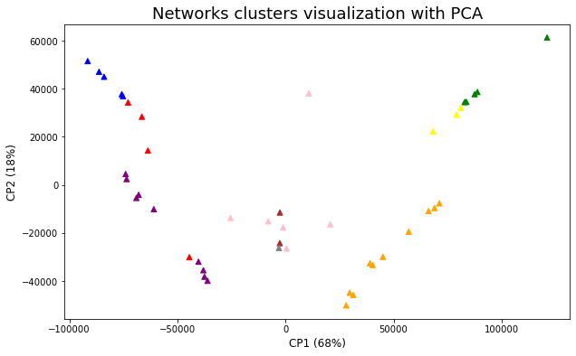
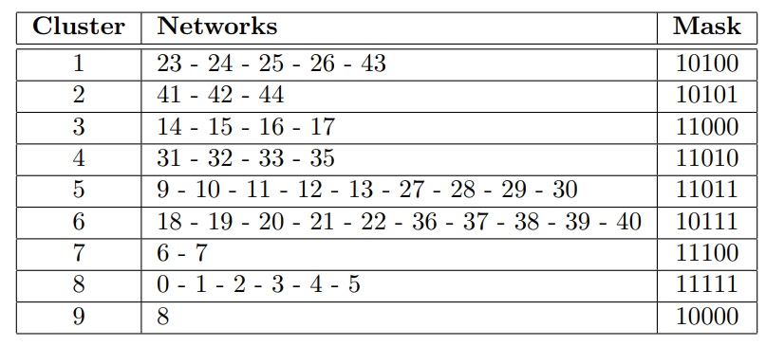
Clustering based on the network’s outputs

Slide 25
08
Our analysis method
Proof of concept with FGSM
Attached deliverable : confusion_matrix_analysis.ipynb
adv_pts_displacement_analysis.pynb
8/11

Slide 26
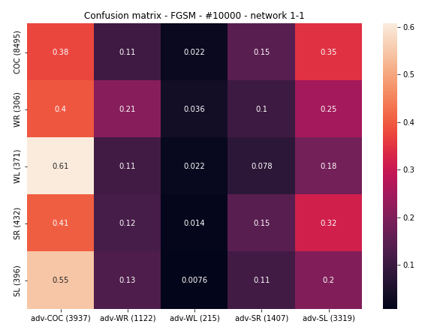
An approach based on confusion matrices
Statistical approach
Quantify the impact of a given attack on a neural network
Use a set of randomly generated points
Quality of the results depends on the number of points to test
Sensitive to the predictions made on the base points

Slide 27
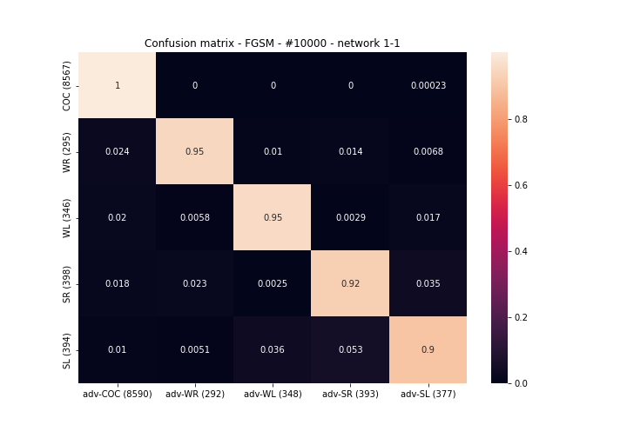
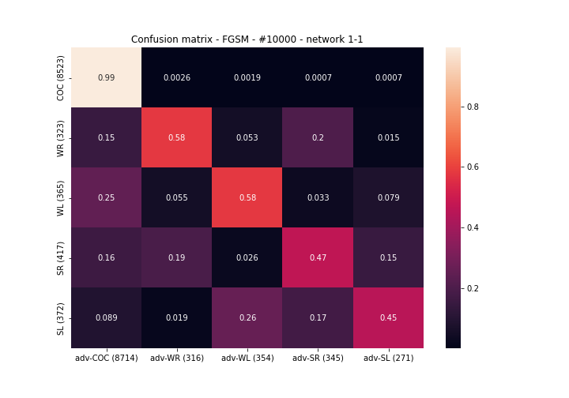
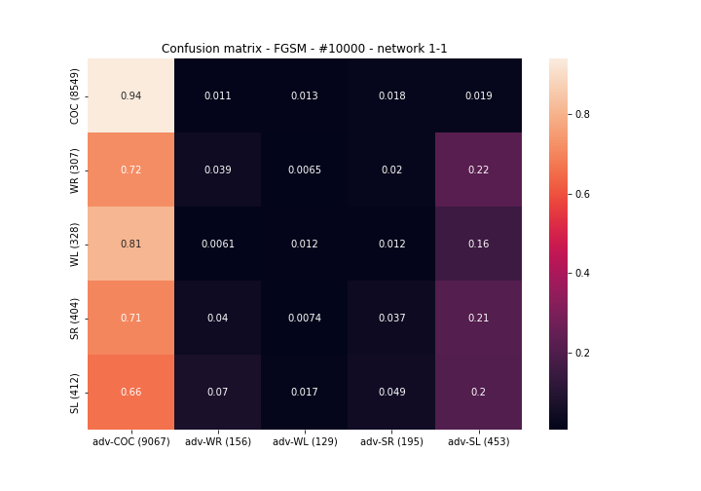
An approach based on confusion matrices
Varying the intensity of the attack FGSM
Intensity = Strength of the attack = Ability to find a point with a different label
High values of intensity gives an adversarial point very different from the base one
Intensity = 0.001
Intensity = 0.01
Intensity = 0.1

Slide 28
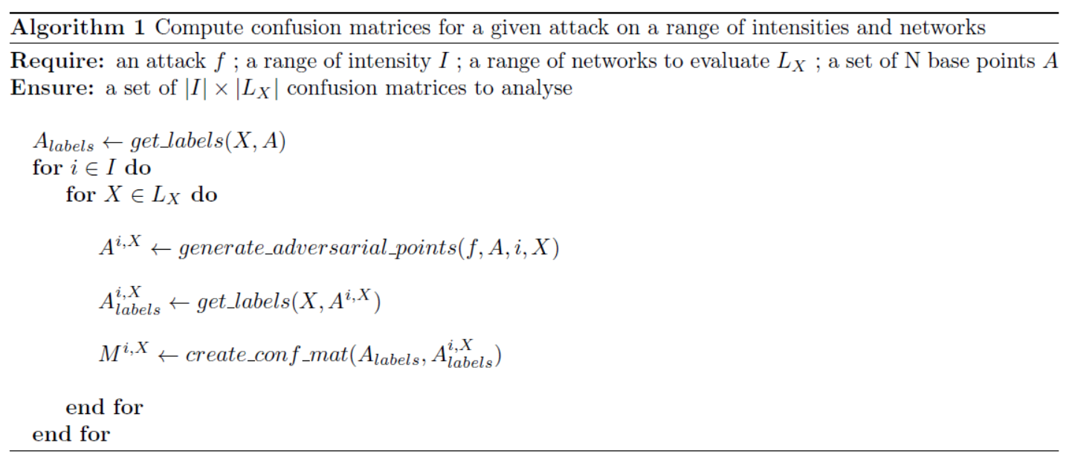
An approach based on confusion matrices
Study the evolution of the confusion matrix coefficients when increasing the attack's intensity

Slide 29
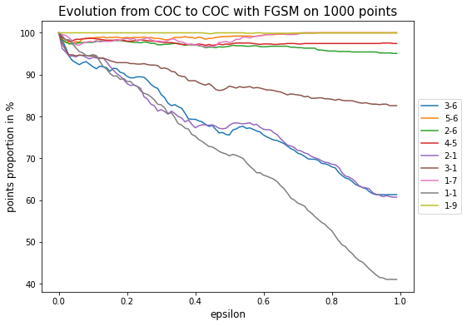
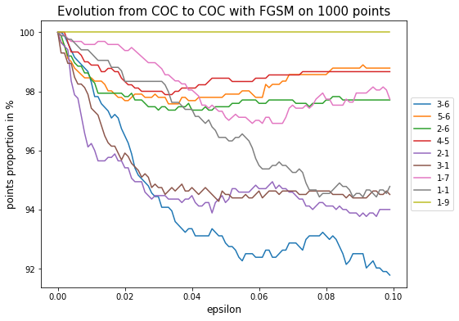
Deviations analysis with the chosen networks
Visualize the evolution of coefficient [COC to COC] on two different scales of intensity

Slide 30
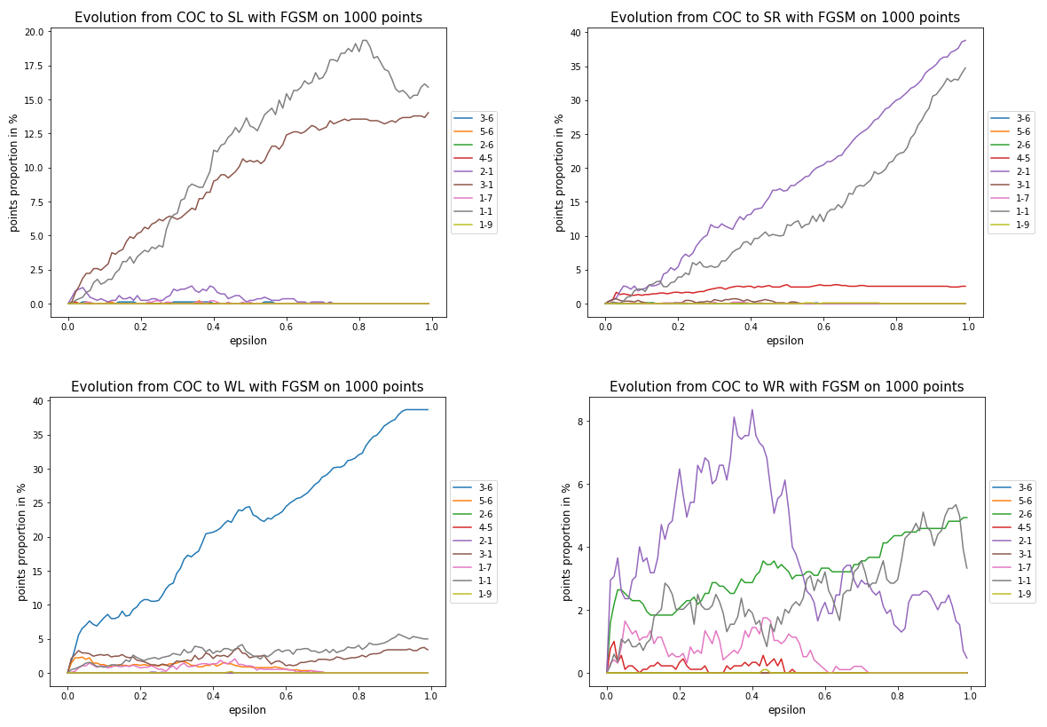
Deviations analysis with the chosen networks
Other interesting coefficients of the confusion matrix
Identify networks with unique behaviours such as :
1-1 = GREY
2-1 = PURPLE
3-1 = BROWN
3-6 = BLUE

Slide 31
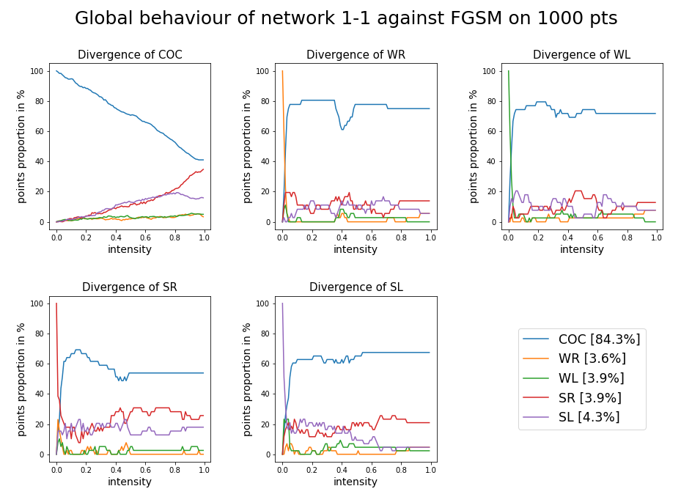
Deviation study of some specific networks
Condense the information about the behaviour of a single network

Slide 32
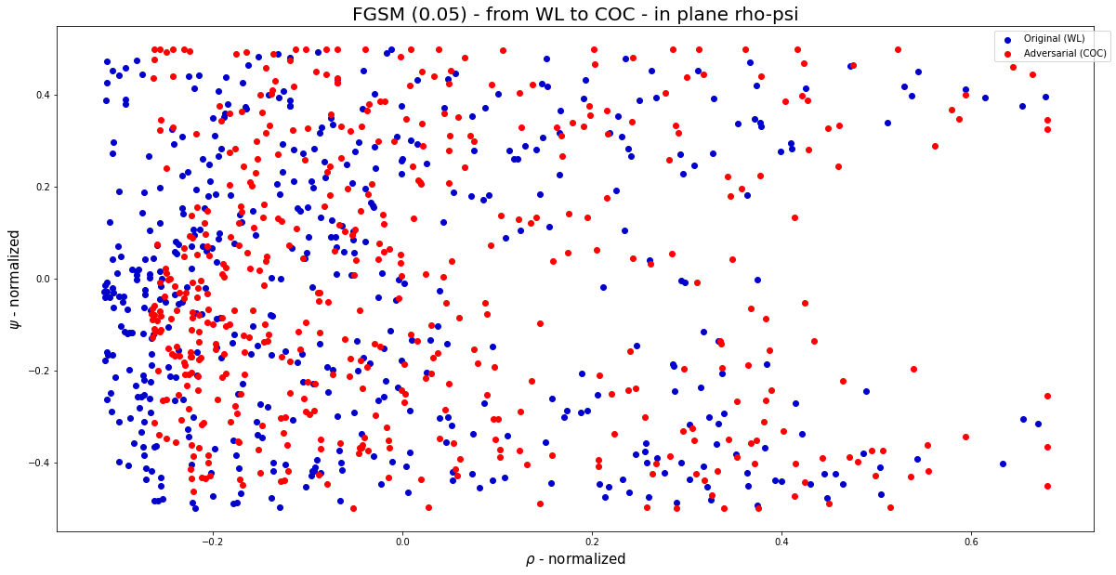
Clustering of adversarial points

Slide 33
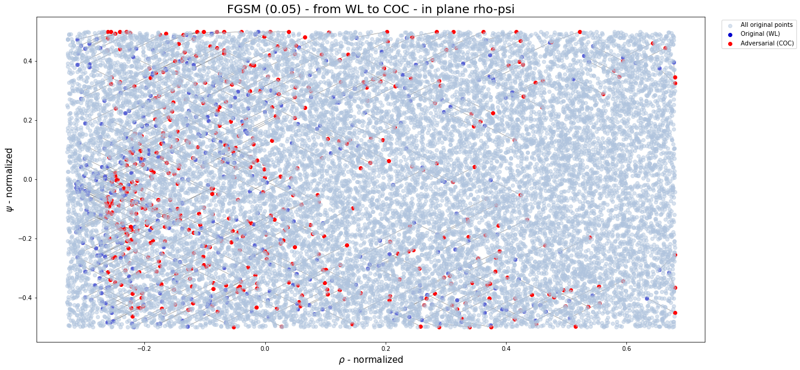
Clustering of adversarial points

Slide 34
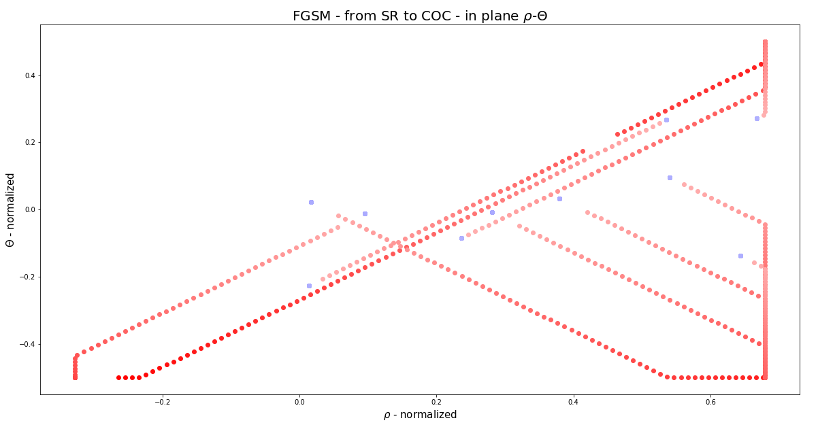
Evolution of the components under attack
More red = higher intensity
Very linear!

Slide 35
Evolution of the components under attack
More red = higher intensity
Very linear!

Slide 36
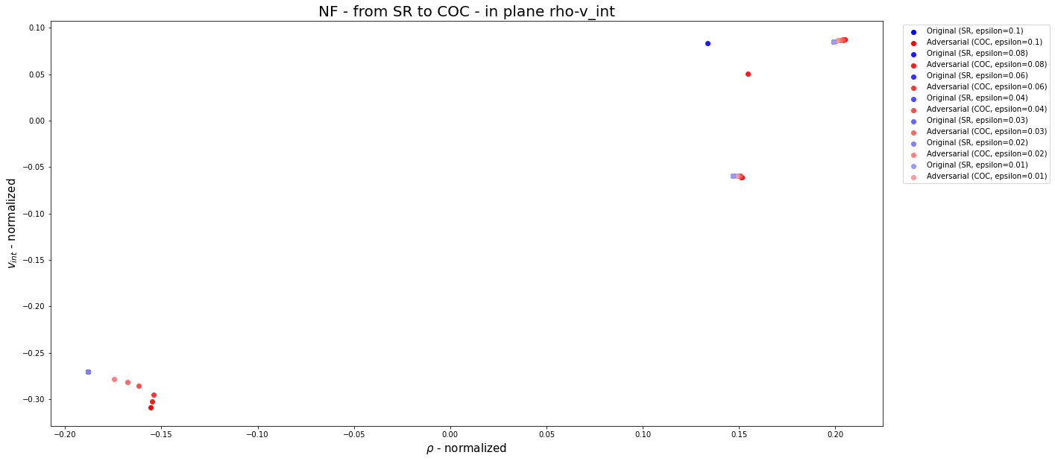
Evolution of the components under attack
Not so linear, but less points

Slide 37
09
Application on other attacks
An attempt to tackle iterative attacks
Attached deliverable : confusion_matrix_analysis.ipynb
9/11

Slide 38
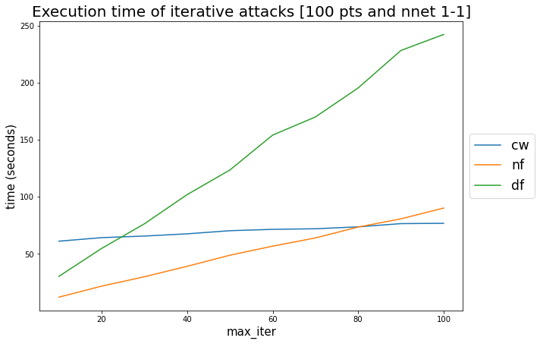
Study of execution time
FGSM : almost instantaneous!

Slide 39
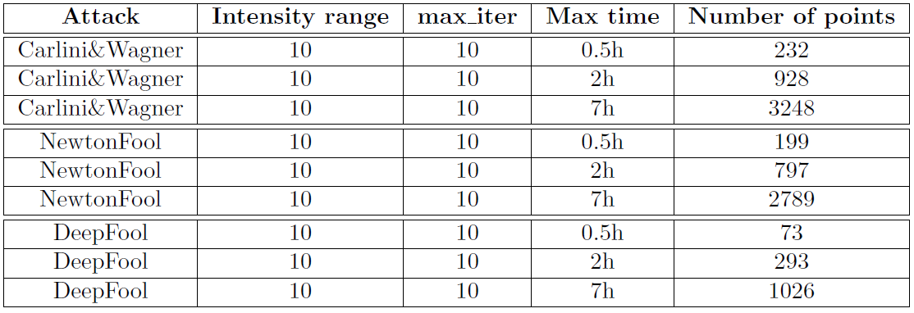
Time constraints
Iterative methods
Table generated using linear approximations
FGSM: 0.5h = 200000 points (intensity 0,1)

Slide 40
10
Evaluation metrics
A way to overcome time complexity of the attacks
Attached deliverable : robustness_metric_analysis.ipynb
10/11

Slide 41
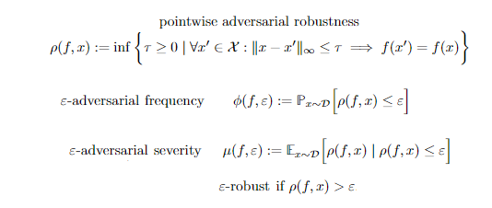
Theoretical definitions

Slide 42
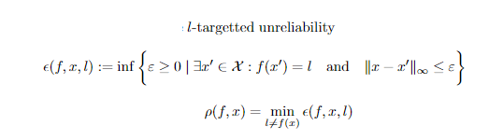
Targetted unreliability

Slide 43
Compute pointwise targeted robustness
Linear Optimization
Decision variables :
t (perturbation)
y_{j,k} (k^{th} output of each layer j)
x_{i} (i^{th} input)
Constraints :
Neural networks constraints (with linear approximation of ReLU functions)
Perturbation constraints
Target contraints

Slide 44
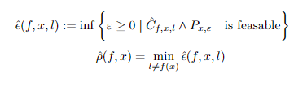
Compute pointwise targeted robustness

Slide 45
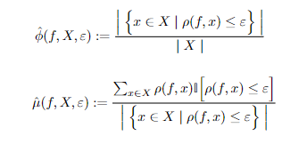
Statistical estimators

Slide 46
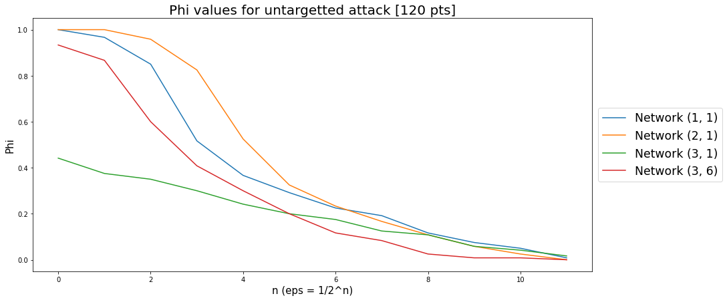
Results

Slide 47
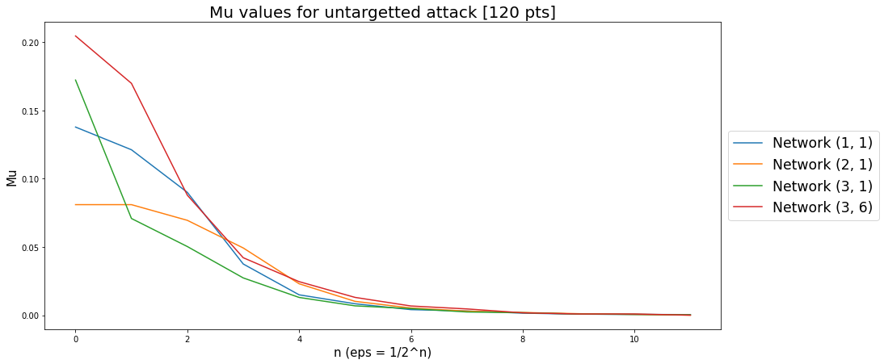
Results

Slide 48
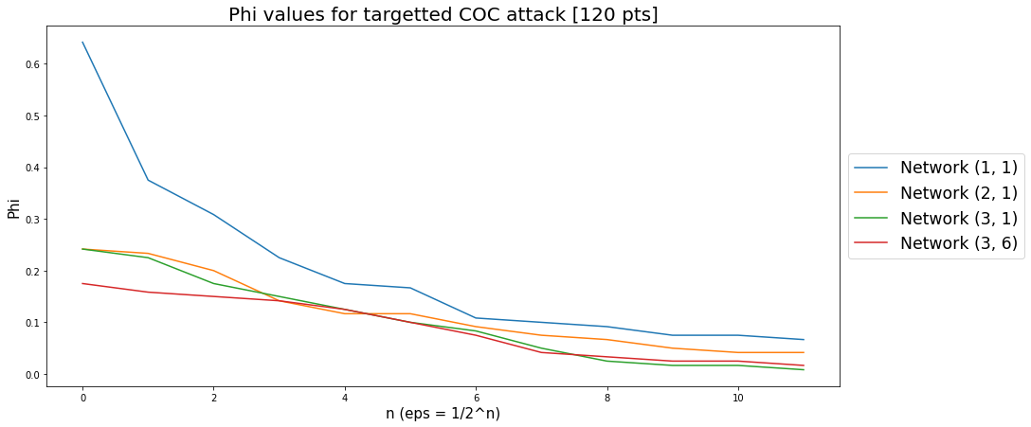
Results

Slide 49
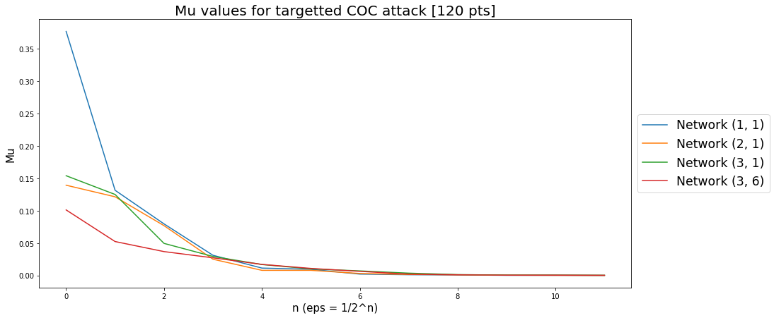
Results

Slide 50
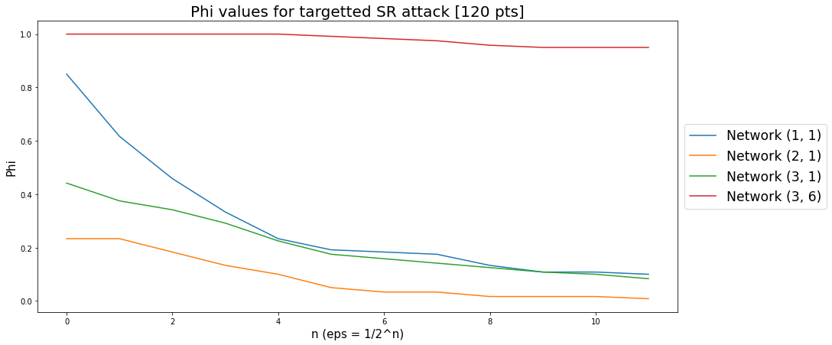
Results

Slide 51
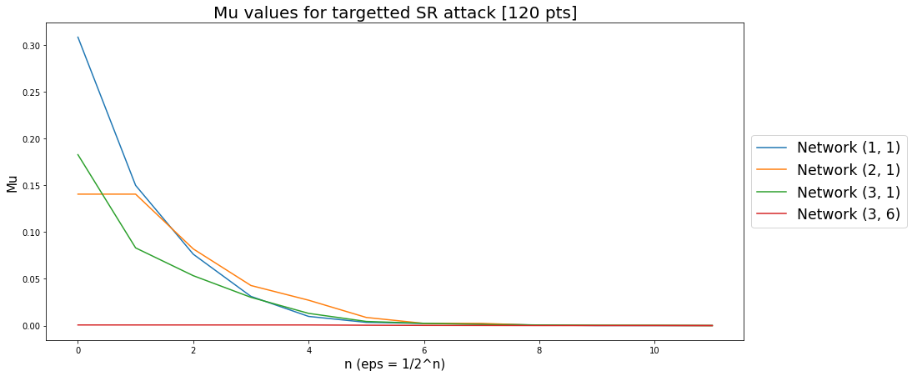
Results

Slide 52
Go further with this method
Run the program on a more powerful machine and on more points and with all the networks
needs about 1 minute per data point per network
Allows to compare the networks and see which ones need to be improved
Implement the RELUPLEX method :
Same algorithm but with properties constraint instead of perturbation constraints
Gives another understanding of adversarial points

Slide 53
11
Feedback on the project and future paths
11/11

Slide 54
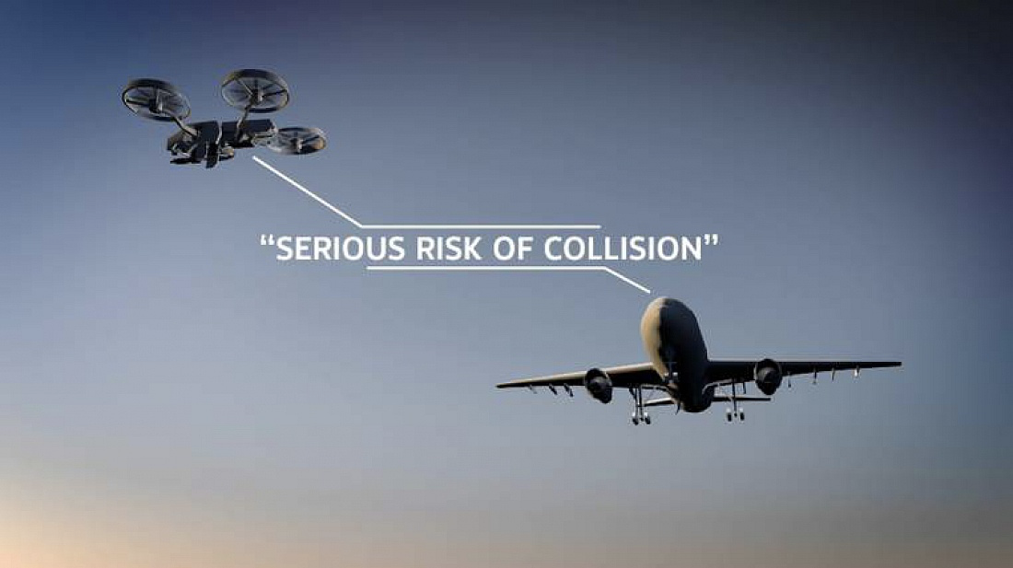
ETHIC & SOCIAL RESPONSIBILITY
The study of adversarial attacks has the positive impact of fostering a safer, more stable environment for those working with around the collisions
Ethically, we are responsible to give honest data because there is are high consequences if the system were to fail

Slide 55

FUTURE PATHS FOR OUR PROJECT
Parallel computing / Cloud computing
Analyse other attacks
Get a more accurate clustering of the neural networks
Analyse the behaviour of an attacked aircraft as the decision are continuous
FROM : prace-ri.eu - Partnership for Advanced Computing in Europe
Inauguration of Joliot-Curie, The French Supercomputer in CEA

Slide 56
Thank you for your attention!
Questions ?

